Slide 1

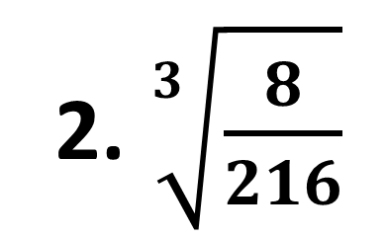
Objective: Student will be able to use numbers expressed in scientific notation and perform different types of operations.
Bell Work
Answer the following:
$$1. \sqrt{\frac{9}{25}}$$
2. $\sqrt[3]{\frac{8}{216}}$

Slide 2
Unit: Exponents & Scientific Notation Topic: Scientific Notation

Slide 3
Scientific Notation
Scientific notation is a shorthand way of writing really large or really small numbers.
Scientific notation is written as a product of two numbers
The first number must be between 1 and 10
The second number must be a power of 10

Slide 4
Converting Standard to Scientific Notation
Create a number between 1 and 10 by moving the decimal
Count the number of times that you moved the decimal. This number will be your power of 10.
If your number is greater than one, the exponent will be positive.
If your number is less than one (like a decimal), the exponent will be negative.

Slide 5

Examples:
1)$1,234,000$
2) $34,000$
3) $0.000374$
4) $0.0023$

Slide 6
Converting Scientific to Standard:
Move the decimal the same number of places as the exponent.
If the exponent is positive, move the decimal to the right in order to make the number larger. (Add zeros as placeholders if necessary)
If the exponent is negative, move the decimal to the left in order to make the number smaller. (Add zeros as placeholders if necessary)

Slide 7

Examples:
$2.45 ×{10}^{6}$
$3.4×{10}^{2}$
$8.312×{10}^{−4}$
$5×{10}^{−5}$

